Slide 1
Review Sentiment Analysis: Key Insights
Summarizing Sentiment Trends and Verified Trips Impact

Slide 2
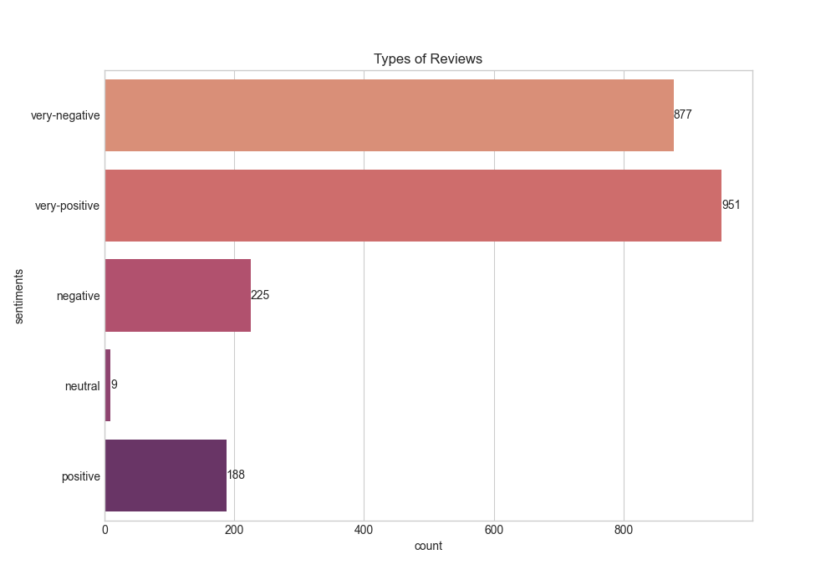
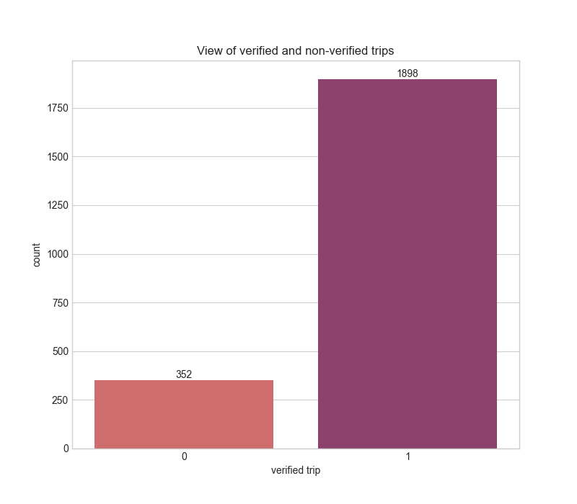
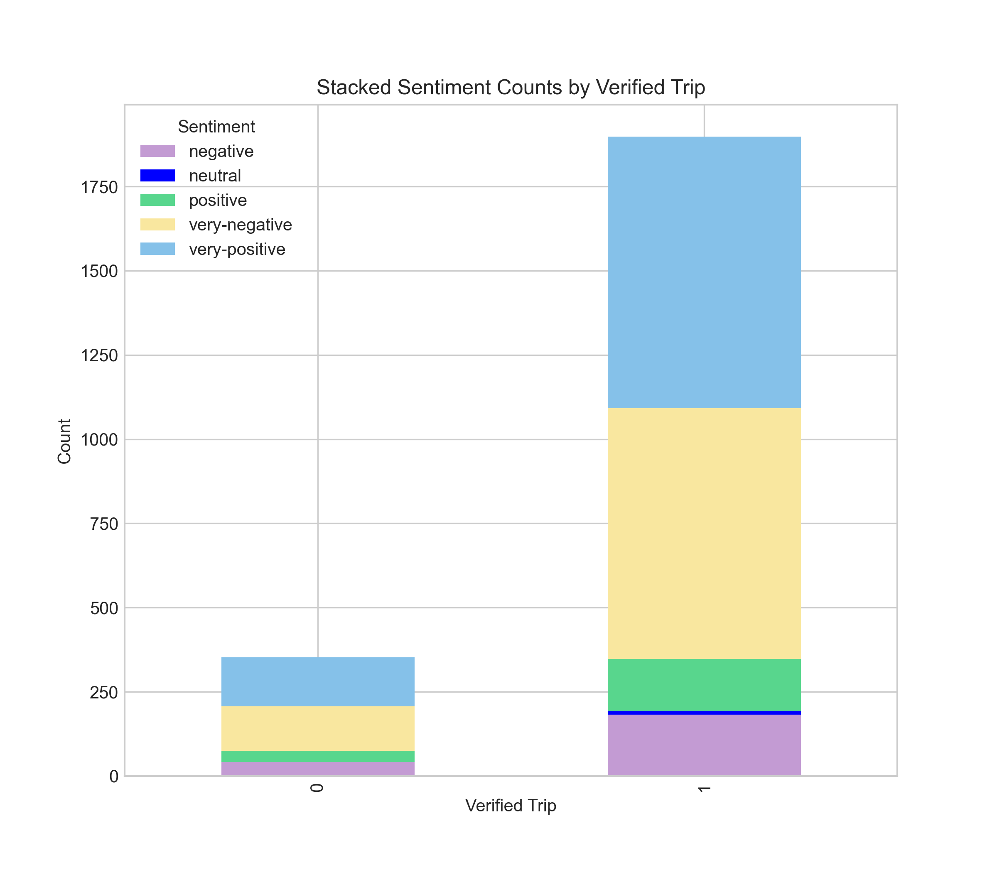
Metric 1: 951 very-positive and 887 very-negative reviews dominate (total 2,250), with neutral (9) and positive (188) minimal.
Metric 2: Verified trips (1,898) outnumber non-verified (352), with stronger very-positive sentiment.
Insight: Extreme sentiments highlight strengths (very-positive) and areas for improvement (very-negative).
Action: Leverage positive feedback; address negative concerns.

